Slide 1

E D U C T I O N A L P S Y C H O L O G Y S E R V I C E
Precision Teaching with ‘Letters and Sounds’
Session 2
All Saint’s Junior School
Scott I-Patrick

Slide 2
Session Aim
Sharing our experiences since the last session
How do I deliver PT?
Target setting
Teaching and probing
Charting the results with target child
Monitoring: Review and adapt the programme as needed

Slide 3
How do I deliver precision monitoring?
Identify a specific difficulty and acquire a baseline.
Set a target.
Teaching sessions: short, frequent and target specific.
Monitor child’s daily performance using a probe.
Chart results and make note of teaching methods.
Analyse the data to determine if a change of target is needed or change in teaching method.

Slide 4
STEP 1
Identify a specific difficulty and acquire a baseline

Slide 5
Step 2 - Setting a Target
SMART TARGETS
S
Specific
Measurable
Agreed
Realistic
Time bound
M
A
R
T

Slide 6
2. Targets
Target needs to contain three essential components:
Observable verb
(ie. what the child will do)
Conditions
(e.g. teaching materials or teacher instructions)
Criterion
(success criteria – how will we know it’s been successful?)

Slide 7
2. Targets
E.g.
“Scott will read aloud (observable verb) 50 words per minute with no more than 2 errors (conditions) on three consecutive days (criterion).”

Slide 8
Step 3- Teaching (Up to 10 mins per day)
Choose up to three words the child struggled with from your baseline assessment (NB: the number of words chosen to focus on may vary according to child’s difficulties).
Introduce the target words to child.
Use teaching strategies which will increase opportunities for child to recognise the words.

Slide 9
3. Teaching methods
E.g. Direct Instruction
Model (adult) – “this word says…”
Lead (together) – “say it with me”
Test (child) – “you say it”… or “what word?”
Use the model-lead-test sequence with each sight word in turn
Alter the sequence and continue until each word has been repeated 3-5 times
Explain to the pupil that they are going to try the sight words alone- but they may have help if they want it
The pupil tries the words alone – praise correct answers. If the word is incorrect or if the pupil hesitates more than 2 seconds use the correction procedure:
Model (adult) “this word says…”
Test (child) “now you say it”… or “what word?”

Slide 10
3. Examples of some teaching methods:
Magnetic Letters
Can you use the letters to make the words: is that had went
A S T
D H I Y
A E W

Slide 11
3. Examples of some teaching methods:
Jumbled Letters Activity
Can you find these words below?
is that had went
W D A T
I N E H T H
S T A
T
A H T T W
N E

Slide 12
Points to remember
Make sure the pace is good- keep things flowing
Include pointing, to signal the pupil’s turn
Include intonation
Praise must be immediate, specific, positive
Avoid word-building- just give the sight word

Slide 13
Step 4 – Monitoring Performance
Using a Probe sheet
What is a probe sheet?

Slide 14
Basic ‘Probe’ sheet
The Probe sheet is the stimulus for a short timed test (a ‘Probe’) usually for 1 minute in duration
A sheet with target
words in randomised
order is used for
reading – ‘see to say’
The child is timed and reads as many words as they can in 1 minute (go back to top of probe if child reads all the words in under a minute).
Name aim rate

Slide 15
Types of probe:
See to say e.g. letter, number, sight word recognition
Hear to write e.g. letter sounds, numbers, spellings
See to write e.g. 3 + 6 =

Slide 16
Designing Probes
High Frequency
Progression through high frequency sightwords listed in ‘Letters and Sounds’
Phonic Development
The content of the probe is rule bound i.e. the probe should include as many examples as possible to test the rule

Slide 17
PT Probe Generator
http://johnandgwyn.co.uk/probe.html

Slide 18
Step 5- Chart Results
Chart results with the child – helps to motivate the child & increase confidence.
Helps teacher to see which teaching methods are most effective for particular pupil (record on chart).
Record any changes made to task.
Record the number of correct AND incorrect words.
If you are unable to do the probe on a particular day, that line is left blank.

Slide 19
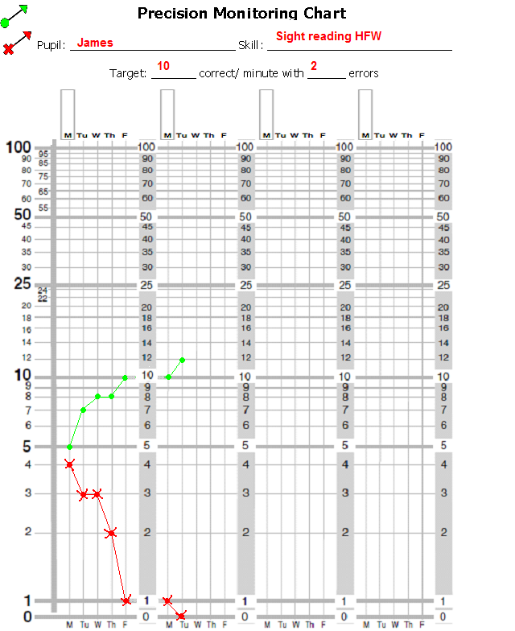

5. Recording
Pupil_______________
Criterion:
_____ correct with
max ____errors
Key:
Correct answers
Incorrect answers
Remember: Do not join across
weekends or across days when a
pupil was not tested.

Slide 20
5. Ratio charts
The days the information is collected
This is shown on the horizontal axis.
There is a line for each school day.
The result is filled in on the line (NOT the space).
If you are unable to do the probe on a particular day, that line is left blank.
That day is known as a No Chance Day.
A description of the pupil’s performance
This is shown on the vertical axis.
It tells you the accuracy at which the pupil does the task.
This is expressed as a rate measurement i.e. the number of responses per minute.

Slide 21
Setting Aim Rates
Suggested minimum Fluency Markers:
Infant Pupils = 40 correct per minute
Junior Pupils = 50 cpm
Secondary = 60 cpm
Suggested minimum
Accuracy Markers:
See-to-say = 3 or less
MAINTENANCE- ACHIEVE THE TARGET FOR 3
CONSECUTIVE DAYS
See-to-say

Slide 22
Step 6- Analyse the Data
Once the child has hit their target for 3 consecutive days move on to a new set of words.
The 3 day rule
Check after 3 days:
If the task appears too hard consider reducing the demands of the task (e.g. number of words to be learnt, types of words being learnt).
The 8 day rule
Check after 8 days:
If the pupil is not at or near their target after 8 days consider a change (e.g. increasing motivation, modifying teaching method, changing task).

Slide 23
6a. Change - response to data analysis
Chart Description
Chart Picture
Interpretation
Intervention
More errors than correct: No sign of a switch
x
Task inappropriate
3 day rule applies
Return or slice the task
Switch within first 3 days
x
Task probably inappropriate. Monitor progress, may be a blip
May need to return or slice the task
Both correct and incorrect rates increasing
x
Pupil is merely getting faster attempting more on the probe
Slow pupil down; encourage accuracy before speed
Some progress; accurate but shallow correct rate slope
x
Task is likely to be appropriate but progress not fast enough
Increasing motivation through rewards/ incentives or alter teaching methods

Slide 24
6b. Maintenance
Once a pupil has reached fluency (hit target 3 days consecutively), change target
Check for maintenance at regular intervals by using an old probe to check they are still fluent with these words or interleave previously learnt words with new words

Slide 25
Recap of the steps of precision monitoring
Identify a specific difficulty and acquire a baseline
Set a target
Teaching sessions (DI): short, frequent and target specific
Monitor pupil’s daily performance using a probe
Chart results (PM) and make note of teaching methods
Analyse the data to determine if a change of target is needed or change in teaching method

Slide 26


E D U C A T I O N A L P S Y C H O L O G Y S E R V I C E
Thank you
Please do not use or copy any slides without prior permission from RBWM EPS

